Slide 1
User Experience designing with aesthetics through bodily and emotional engagements
Kristina Höök
Professor in Interaction Design
Royal Institute of Technology (KTH)
Notes:
We are at a watershed moment where our relationship to technology is about to undergo a dramatic and irreversible shift. With the rise of ubiquitous technology, data-driven design and the Internet of Things, our interactions and our interfaces with technology will look radically different in the years ahead, incorporating changes like full body interaction, shape-changing interfaces, wearables and movement tracking apps. These changes offer an enormous opportunity—indeed, a necessity—to reinvent the way we interact with the inanimate world. Once-familiar, everyday objects, from our phones to our vacuums, require novel interaction models – not just typing text on screens, but, increasingly, movement-based, bodily communication. A qualitative shift is required in our design methods, from a predominantly symbolic, language-oriented design stance, to an experiential, felt, aesthetic stance permeating the whole design and use cycle.

Slide 2
Soma Design Manifesto
We design for living better lives – not for dying
We design to move the passions in others and ourselves
We are movement, through and through
We design with ourselves – through empathy and compassion
We design slowly
We cultivate our aesthetic appreciation
We disrupt the habitual & engage with the familiar

Slide 3
How do you feel?
Notes:
Close your eyes
Sit on both your sitting bones, both feet on the floor, grounded
Are you sitting bones symmetrical?
Do you have pain anywhere?
How do you feel today?
Stop breathing.

Slide 4
Feldenkrais™
Movement aesthetics
Returning to the basic pleasures of moving – like a baby
Extending your repertory of movements & experiences
Learning more about yourself - directing attention
thenext25years.tumblr.com/
Notes:
We based this particular work on a body practice named Feldenkrais – it was a route to movement aesthetics

Slide 5
Feldenkrais™
Movement aesthetics
Returning to the basic pleasures of moving – like a baby
Extending your repertory of movements & experiences
Learning more about yourself - directing attention
thenext25years.tumblr.com/

Slide 6
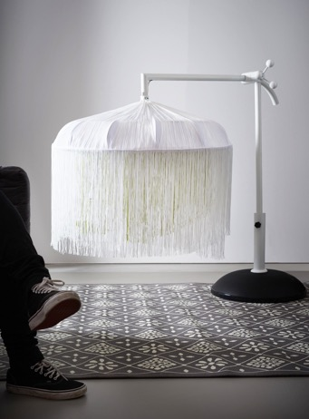
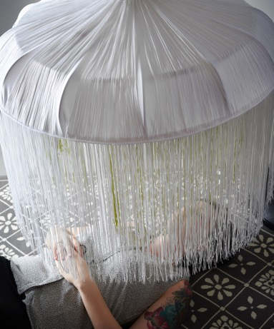
Breathing Light
Put attention to your breathing
Lamp will dim in the same tempo as your breathing
Enclosure makes you feel taken care of
(Höök et al., 2016, Höök et al., 2015)
Notes:
STÄNG AV LJUDET

Slide 7
Breathing Light
Put attention to your breathing
Lamp will dim in the same tempo as your breathing
Enclosure makes you feel taken care of
(Höök et al., 2016, Höök et al., 2015)

Slide 8
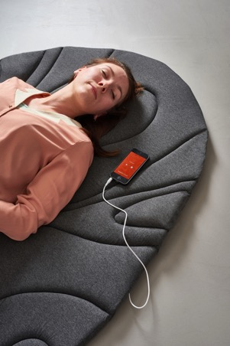
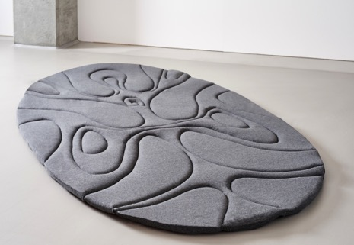
Soma Mat
Guiding attention with heat
Heating up underneath your different body parts to help direct attention
The heat follows Feldenkrais instructions
(Höök et al., 2016, Höök et al., 2015)

Slide 9
Soma Mat
Guiding attention with heat
Heating up underneath your different body parts to help direct attention
The heat follows Feldenkrais instructions
(Höök et al., 2016, Höök et al., 2015)

Slide 10
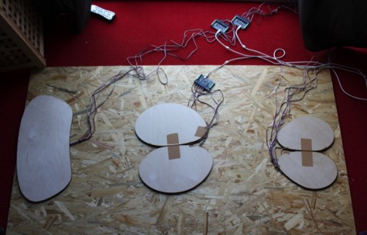
Sarka
Sarka presented in two different, playful, manners:
A ceiling projection that shows your pressure on the floor in realtime
As a soundscape where you try find harmony between tones by pressure
(Bergström & Jonsson, 2016)

Slide 11
Sarka
Generating visualisations small & slow
A ceiling projection that shows your pressure on the floor in realtime
(Bergström & Jonsson, 2016)

Slide 12
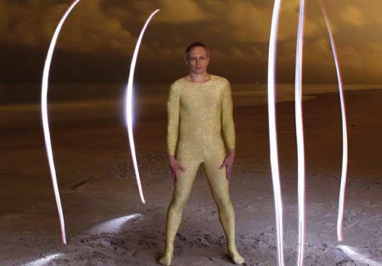
Somaesthetics?
Soma
“Soma as a living, purposive, sentient, perceptive body or bodily subjectivity”
Aesthetics
“an awakening from the mindless, joyless behaviours ”
Analytical & Practical
“the highest art of all – that of living better lives”
(Shusterman, 2015)
Notes:
Soma:
to avoid problematic associations of body (which can be a lifeless, mindless thing) and flesh (which designates only the fleshly parts of the body and is strongly associated with Christian notions of sin)”

Slide 13
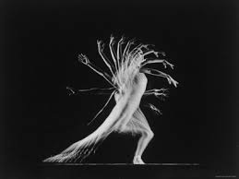
Movement foundational
“Without the readiness to act in a certain way, without certain corporeal tonicities, a certain feeling would not, and indeed, could not be felt, and a certain action would not, and indeed, could not be taken, since the postural dynamic of the body are what make the feeling and the action possible.”
Sheets-Johnstone: Emotion and Movement: A beginning Empirical-Phenomenological Analysis of Their Relationship, Journal of Consciousness Studies, 1999

Slide 14
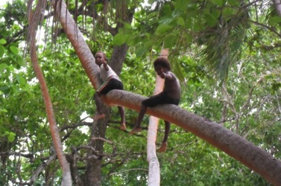
Tech is shaping bodies
“Since we started carrying mobile phones, they have altered the ways in which we orient our bodies in the world. Many of those changes are invisible to us – they have become habits, deeply engrained in our society. By studying one of the last groups of users on earth when first exposed to mobiles, it became clear to us who profoundly they affect our bodily ways of being in the world.”
(Ferreira et al., 2011)

Slide 15
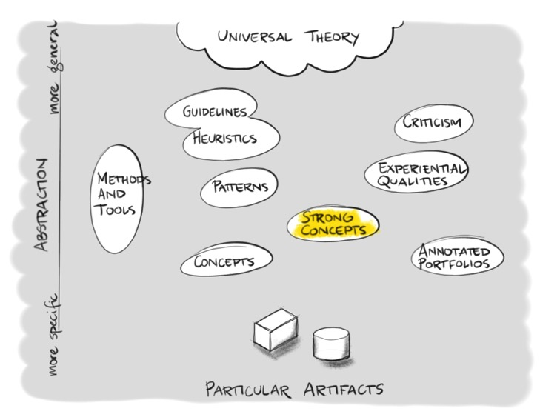
Research through Design RtD

Slide 16
Vertical grounding
Pragmatics
Somaesthetics
Phenomenology
Somaesthetic
Appreciation
Soma Carpet
Breathing
Light
Sonic
Cradle
Slow
Floor
…

Slide 17
Somaesthetic Appreciation
Somaesthetic Appreciation is a strong concept = generative
4 defining qualities

Slide 18
Somaesthetic Appreciation
Subtle guidance
in encouraging bodily inquiry through choice of interaction modalities

Slide 19
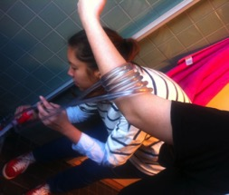
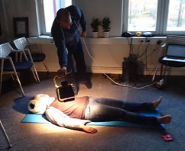
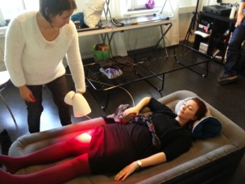
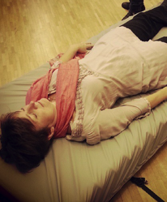
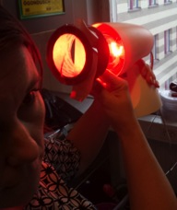
Somaesthetic Appreciation
Subtle guidance
in encouraging bodily inquiry through choice of interaction modalities

Slide 20
Somaesthetic Appreciation
Subtle guidance
in encouraging bodily inquiry through choice of interaction modalities
Intimate correspondence
feedback and interactions that follow the rhythm of the body

Slide 21
Somaesthetic Appreciation
Subtle guidance
in encouraging bodily inquiry through choice of interaction modalities
Intimate correspondence
feedback and interactions that follow the rhythm of the body
“And I don’t know if it, it doesn’t always sync up, because sometimes when you breathe out in a different way or something then it recognizes it as a breathing in so then the light turns brighter so sometimes it’s off. And then it’s kind of strange because then you are like ‘I am breathing out, it should dim but it is breathing in’ the light itself breathing in.“

Slide 22
Somaesthetic Appreciation
Subtle guidance
in encouraging bodily inquiry through choice of interaction modalities
Intimate correspondence
feedback and interactions that follow the rhythm of the body
Making space
shutting out the outside world – metaphorically and literally – to turn attention inwards

Slide 23
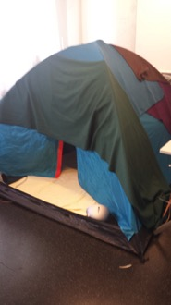
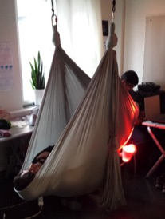
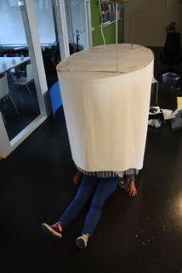
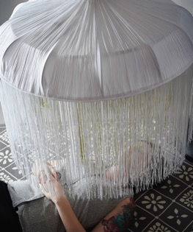
Somaesthetic Appreciation
Subtle guidance
in encouraging bodily inquiry through choice of interaction modalities
Intimate correspondence
feedback and interactions that follow the rhythm of the body
Making space
shutting out the outside world – metaphorically and literally – to turn attention inwards

Slide 24
Somaesthetic Appreciation
Subtle guidance
in encouraging bodily inquiry through choice of interaction modalities
Intimate correspondence
feedback and interactions that follow the rhythm of the body
Making space
shutting out the outside world – metaphorically and literally – to turn attention inwards
Articulation
of bodily experiences to encourage learning and increased somatic awareness

Slide 25
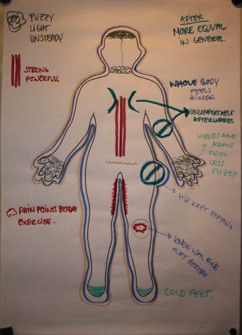
Somaesthetic Appreciation
Subtle guidance
in encouraging bodily inquiry through choice of interaction modalities
Intimate correspondence
feedback and interactions that follow the rhythm of the body
Making space
shutting out the outside world – metaphorically and literally – to turn attention inwards
Articulation
of bodily experiences to encourage learning and increased somatic awareness
Notes:
Berätta om killen som inte fick arbetstillstånd

Slide 26
Vertical grounding
Pragmatics
Somaesthetics
Phenomenology
Somaesthetic
Appreciation
Soma Carpet
Breathing
Light
Sonic
Cradle
Slow
Floor
…

Slide 27
Horizontal grounding
Pragmatics
Somaesthetics
Phenomenology
Affective
Loops
Somaesthetic
Appreciation
Biofeedback
loops
Bareskin
connection
Somaesthetic
touch
Extended Lived Body
Machine
Aesthetics
….

Slide 28
Horizontal grounding
Pragmatics
Somaesthetics
Phenomenology
Affective
Loops
Somaesthetic
Appreciation
Biofeedback
loops
Bareskin
connection
Somaesthetic
touch
Extended Lived Body
Machine
Aesthetics
….

Slide 29
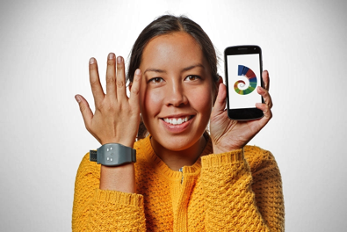
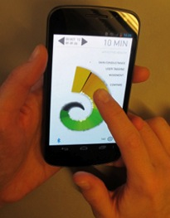
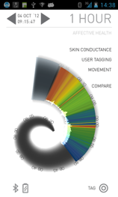
Affective Health
Bio-feedback loop through mirroring sensor data on their mobile phones
Scroll back to discover patterns in their behaviours and reactions
Sensors pick up on movement and skin conductivity
Notes:
STÄNG AV LJUDET

Slide 30
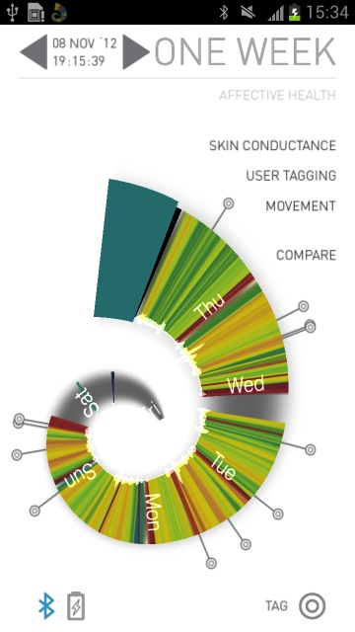
Relaxing evening with my family
Recovery after work out, always relaxed
Throwing garbage away, renting a trailer, driving to the tip, a lot happening at once.
Work out at the gym. Aerobics, nice!
Putting my daughter to bed, reading to her, cosy!
Running around like crazy at home, packing bags, checking homework,
laundry, dishes, stressful.
Notes:
Not social
Only mirroring – but what to do?

Slide 31
Horizontal grounding
Pragmatics
Somaesthetics
Phenomenology
Affective
Loops
Somaesthetic
Appreciation
Biofeedback
loops
Bareskin
connection
Somaesthetic
touch
Extended Lived Body
Machine
Aesthetics
….
BrightHearts
Affectiva
Affective Diary
Affective Health
…

Slide 32
Horizontal grounding
Pragmatics
Somaesthetics
Phenomenology
Affective
Loops
Somaesthetic
Appreciation
Biofeedback
loops
Bareskin
connection
Somaesthetic
touch
Extended Lived
Body
Machine
Aesthetics
….

Slide 33
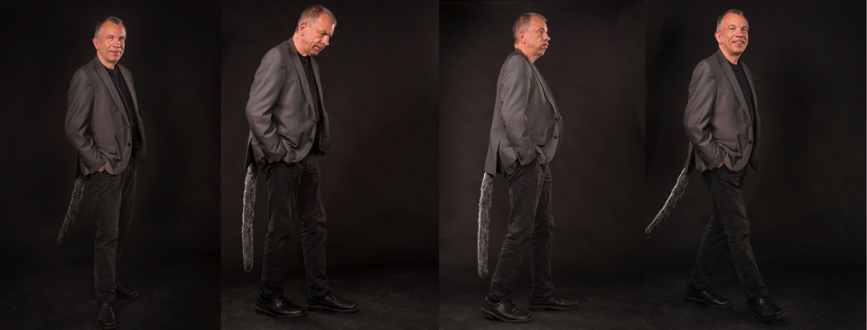
Extended Lived Body

Slide 34
Tail

Slide 35
Horizontal grounding
Pragmatics
Somaesthetics
Phenomenology
Affective
Loops
Somaesthetic
Appreciation
Biofeedback
loops
Bareskin
connection
Somaesthetic
touch
Extended Lived
Body
Machine
Aesthetics
….

Slide 36
Horizontal grounding
Pragmatics
Somaesthetics
Phenomenology
Affective
Loops
Somaesthetic
Appreciation
Biofeedback
loops
Bareskin
connection
Somaesthetic
touch
Extended Lived
Body
Machine
Aesthetics
….

Slide 37
Bareskin Connection

Slide 38
Horizontal grounding
Pragmatics
Somaesthetics
Phenomenology
Affective
Loops
Somaesthetic
Appreciation
Biofeedback
loops
Bareskin
connection
Somaesthetic
touch
Extended Lived
Body
Machine
Aesthetics
….

Slide 39
Horizontal grounding
Pragmatics
Somaesthetics
Phenomenology
Affective
Loops
Somaesthetic
Appreciation
Biofeedback
loops
Bareskin
connection
Somaesthetic
touch
Extended Lived
Body
Machine
Aesthetics
….

Slide 40
Aesthetics as politics?
“…while modernity’s dominant ideology compartmentalizes and trivializes the aesthetic by sharply distinguishing it from more serious realms of knowledge and praxis (by identifying the aesthetic with mere prettiness, appearance, surface, form, play, fantasy, etc.), somaesthetics blends aesthesis, cognition, and praxis to address some of philosophy’s most central aims: knowledge, self-knowledge, right action, happiness, and justice.”
(Shusterman)

Slide 41
Body as politics?
Dualism
Feminism
Privilege
Tech role

Slide 42
Body as politics?
Separates body from mind
Separates us from the world we live in
Goes all the way back to Plato and the idea world
Bodies associated with lower status, while the mind is where the higher faculties reside
The body – a mere instrument, a tool that we can control, trim, keep perfect, not the fundamental condition through which I am in the world
Emotion resurrected - but made into a tool for rationality & survival
Dualism
Feminism
Privilege
Tech role

Slide 43
Body as politics?
Pluralism: bodies & subjective selves are different
Gender is in part biological & in part social
Dualism
Feminism
Privilege
Tech role

Slide 44
Body as politics?
Esoteric practices for the rich?
1. Esoteric: somaesthetic experiences a freedom and basic right for all: living a better life!
2. Rich: no, relevant to all design
Dualism
Feminism
Privilege
Tech role

Slide 45
Body as politics?
Layers of technology creating distance between our “language-symbolic-oriented” selves and the “soma” selves?
Dualism
Feminism
Privilege
Tech role

Slide 46
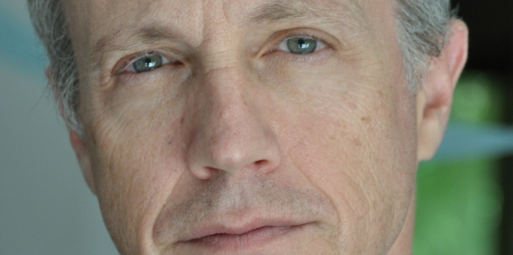
Interfering with the body?
“First, no technological invention of virtual reality will negate the body’s centrality as the focus of affective, perceptual experience through which we experience and engage the world.
Second, that cultivating better skills of body consciousness can provide us with enhanced powers of concentration to help us overcome problems of distraction and stress caused by the new media’s superabundance of information and stimulation.”
Shusterman, R. Somaesthetics. The Encyclopedia of Human Computer Interaction
Can we afford to not engage with somaesthetics?

Slide 47
From sensing to actuation
Actuation in a broader sense – what change are we bringing to the world? Innovative actuation needed!
Research through Design
Somaesthetics ≠ fluffy mindfulness practices, but has broader scope – designing for “good life”, desire & ethics!
Notes:
Biomedical's future: Do we need a SWOT analysis?
With wearables becoming common good, data sources rapidly expanding, computing power steeply increasing, and biomedical scanning improving, biomedical engineering systems and technologies florish. Nevertheless, so far, biomedical's progress is not as disruptive as many hope.
More health apps are available than we can comprehend. fMRI scans can grasp brain activity with a striking spatial resolution. Brain-Computer Interfaces have been posed as a next generation man-machine interface. However, what did these and the many, many other techniques bring us? Are we perhaps generating solutions for self-made problems?
What would biomedical engineering's SWOT analysis unveil? What are its true strengths and what are its weaknesses? What are the opportunities? Which of them is the low hanging fruit and which can challenges can be tackled on the long run? What are the main threats for biomedical engineering's progress? Are it privacy or security issues? Is it quality control?
What does this tell us about the BIOSTEC community? What direction should we take? And what will be this decision's impact upon the lives of our children?

Slide 48
Soma Design Manifesto
We design for living better lives – not for dying
We design to move the passions in others and ourselves
We are movement, through and through
We design with ourselves – through empathy and compassion
We design slowly
We cultivate our aesthetic appreciation
We disrupt the habitual & engage with the familiar

Slide 49
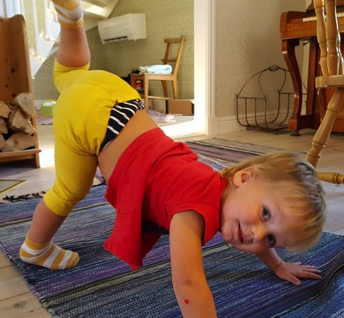
Thank you!
To me Somaesthetic Design brings:
Firm basis in our corporeal realities
Self-knowledge
Compassion
Ethical considerations
Politics
Active intervention
Ideals for how to live a better life
Recognition of different bodies
Work was done in the Mobile Life centre in collaboration with IKEA and Boris Design Ltd
Notes:
Designing with the Body: Somaesthetic Interaction Design

